Slide 1



BOOM
PROCESSOR

Slide 2
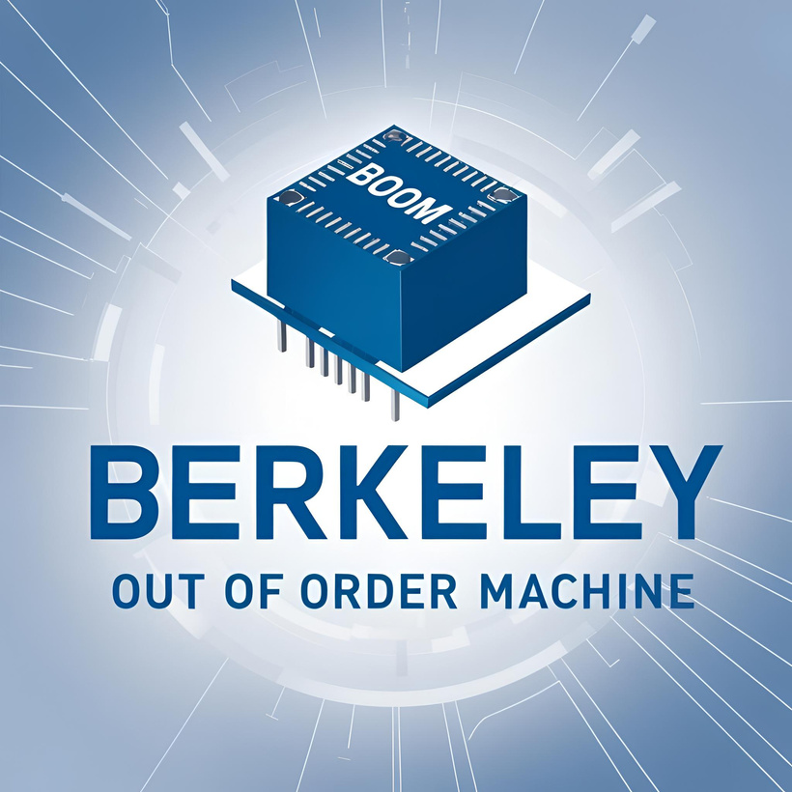
01
REGISTER STRUCTURE
02
ISA
03
DATAPATH
04
PIPELINE
DESKTOP PROCESSOR
05
FEATURES AND REFERENCES

Slide 3
Introduction to BOOM ISA
01
Berkeley Out-of-Order Machine (BOOM) is a high-performance, out-of-order processor based
on RISC-V ISA.
It is an open-source core implemented in Chisel and derived from the Rocket Chip
generator.
Supports 64-bit RISC-V ISA (RV64IMAFD):
I – Integer instructions
M – Multiplication & Division
A – Atomic operations
F – Single-precision floating-point
D – Double-precision floating-point
Optional extensions: C (Compressed), V (Vector), B (Bit Manipulation)
CB.SC.U4CSE23537

Slide 4
ISA Features
01
Execution Modes: Supports User (U), Supervisor (S), and Machine (M) modes.
Memory Management: Uses Sv39/Sv48 virtual memory, supports TLB (Translation Lookaside Buffer).
Pipeline Execution:
1.Multi-stage, superscalar pipeline with out-of-order execution.
2.Dynamic scheduling and branch prediction for higher performance.
Comparison with Rocket Core:
1. BOOM: Out-of-order, high-performance
2. Rocket: In-order, simpler design
CB.SC.U4CSE23537

Slide 5
Registers
02
General-Purpose Registers:
Number & Width: 32 registers (x0 to x31), 64 bits each
Purpose: Store integer data, addresses, and temporary values
Key Registers:
x0: Always holds 0 (zero register)
x1 (ra): Return address register
x2 (sp): Stack pointer
x10 - x17 (a0 - a7): Function arguments and return values
Floating-Point Registers:
Number & Width: 32 registers, 64 bits each
Purpose: Store floating-point values (single and double precision)
CB.SC.U4CSE23566

Slide 6
Registers
02
Control and Status Registers
Purpose: Manage exceptions, interrupts, privilege levels, and performance monitoring
Key CSRs:
mstatus: Processor state and interrupt enable bits
mcause: Cause of the last exception
cycle and instret: Performance counters
Register Renaming and Reorder Buffer
Purpose: Avoids data hazards (e.g., Write-After-Write (WAW) and Write-After-Read (WAR))
Hazard Mitigation:
Structural Hazards: Multiple read/write ports
Data Hazards: Resolved using forwarding
Control Hazards: Managed with branch prediction
CB.SC.U4CSE23566

Slide 7
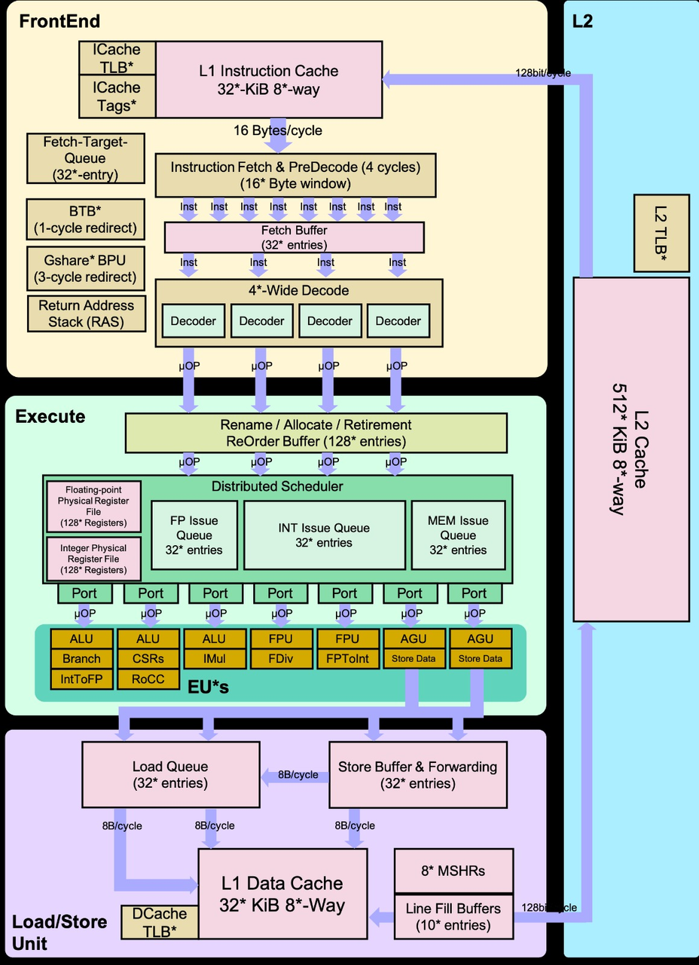
Datapath
03
FRONT-END: Fetches instructions, decodes them, and prepares instruction for execution.
EXECUTION UNITS: Handles arithmetic, memory access, and floating-point operations.
LOAD/STORE UNITS: Manages memory operations efficiently with store buffers and forwarding
CB.SC.U4CSE23520

Slide 8
Datapath Components
03
Front-end (Instruction Fetch & Decode)
Uses Branch Prediction Unit (BPU) for fast instruction flow.
Fetch Buffer (32 entries) holds instructions before decoding.
Execution Units (EUs)
Reorder Buffer (ROB) (128 entries) maintains program order.
Distributed Scheduler assigns operations to execution units.
Execution Units (ALUs, FPUs, IMUL, AGUs) handle different instructions.
Load/Store Unit
L1 Data Cache (32 KiB, 8-way) stores frequently accessed data.
Load & Store Queues manage memory operations.
CB.SC.U4CSE23520

Slide 9
Datapath
03
CB.SC.U4CSE23520

Slide 10
Datapath Components
03
Front-end (Instruction Fetch & Decode)
Instruction Fetching – The L1 Instruction Cache (32 KiB, 8-way set associative) fetches 16 Bytes per cycle, ensuring a high-speed supply of instructions.
Branch Prediction – It minimizes pipeline stalls using the BTB (1-cycle redirect), Gshare BPU (3-cycle redirect), and Return Address Stack (RAS).
Instruction Buffering – The Fetch Buffer (32 entries) temporarily holds instructions before they enter the decode stage.
Decoding – The 4-wide Decode Unit processes four instructions per cycle, translating them into micro-operations (μOPs) for execution.
CB.SC.U4CSE23520

Slide 11
Datapath Components
03
Execution Units (EUs)
Out-of-Order Execution – The processor dynamically schedules instructions to maximize throughput and minimize stalls.
Instruction Scheduling – The Reorder Buffer (ROB, 128 entries) manages renaming, allocation, and retirement of instructions to maintain execution order.
Issue Queues – Instructions are dispatched to FP Issue Queue, INT Issue Queue, and MEM Issue Queue (each with 32 entries) for execution.
Execution Units – Includes ALUs for integer operations, FPUs for floating-point computations, IMUL for multiplication, FDIV for division, and AGUs for memory address calculations.
CB.SC.U4CSE23520

Slide 12
Datapath
03
CB.SC.U4CSE23520

Slide 13
Datapath Components
03
Load/Store Unit
Memory Access – The L1 Data Cache (32 KiB, 8-way set associative) processes 8 Bytes per cycle, improving data access speeds.
Load/Store Queues – Instructions enter the Load Queue (32 entries) and Store Queue (32 entries) before memory operations are executed.
Store Buffering & Forwarding – Enables stores to be processed without waiting for memory, reducing write latencies.
Cache Miss Handling – Line Fill Buffers (10 entries) and 8 Miss Status Holding Registers (MSHRs) manage cache misses and data prefetching.
CB.SC.U4CSE23520

Slide 14
04
The Boom Pipeline
01
Fetch
Instructions are fetched from instruction memory and pushed into a FIFO queue, known as the Fetch Buffer .
Branch prediction also occurs in this stage.
02
Decode
Decode pulls instructions out of the Fetch Buffer and generates the appropriate Micro-Op(s) (UOPs) to place into the pipeline.
03
Rename
The ISA, or “logical”, register specifiers (e.g. x0-x31) are then renamed into “physical” register specifiers.
CB.SC.U4CSE23542

Slide 15
04
The Boom Pipeline
04
Dispatch
The UOP is then dispatched, or written, into a set of Issue Queue s.
05
Issue
UOPs sitting in a Issue Queue wait until all of their operands are ready and are then issued.
This is the beginning of the out–of–order piece of the pipeline.
06
Register Read
Issued UOPs s first read their register operands from the unified Physical Register File (or from the Bypass Network)…
CB.SC.U4CSE23542

Slide 16
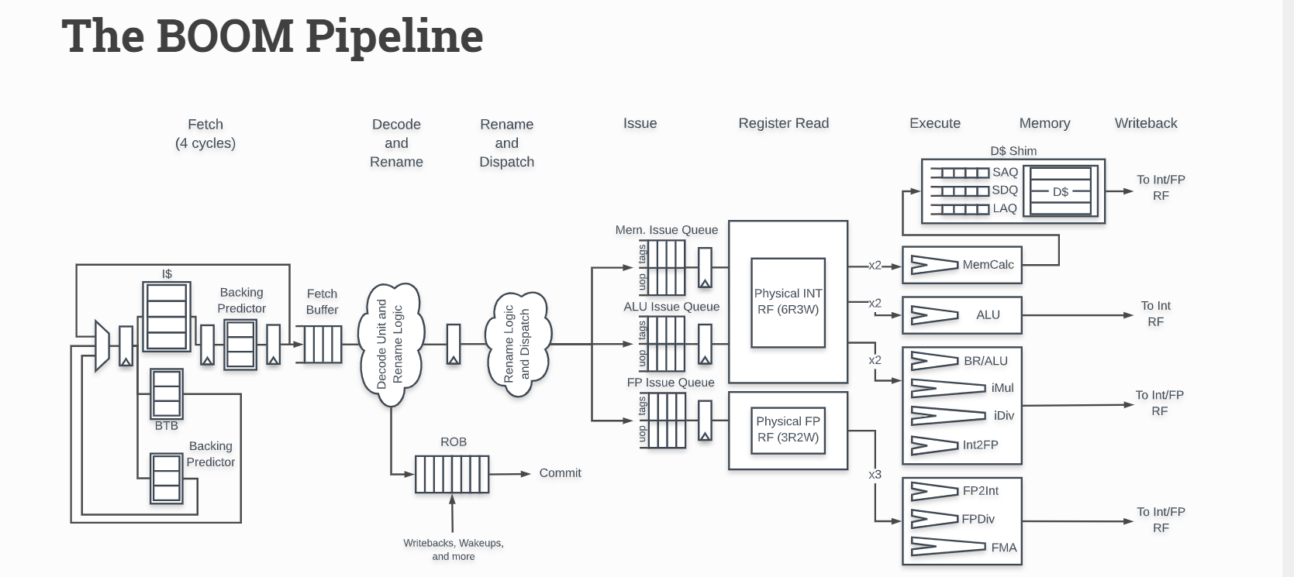
04
The Boom Pipeline
CB.SC.U4CSE23542

Slide 17
04
The Boom Pipeline
07
Execute
The Execute stage is where the functional units reside.
Issued memory operations perform their address calculations in the Execute stage, and then store the calculated addresses in the Load/Store Unit which resides in the Memory stage.
08
Memory
The Load/Store Unit consists of three queues: a Load Address Queue (LAQ), a Store Address Queue (SAQ), and a Store Data Queue (SDQ).
Loads are fired to memory when their address is present in the LAQ.
CB.SC.U4CSE23542

Slide 18
04
The Boom Pipeline
09
Write back
ALU operations and load operations are written back to the Physical Register File.
10
Commit
The Reorder Buffer (ROB), tracks the status of each instruction in the pipeline.
When the head of the ROB is not-busy, the ROB commits the instruction.
For stores, the ROB signals to the store at the head of the Store Queue (SAQ/SDQ) that it can now write its data to memory.
CB.SC.U4CSE23542

Slide 19
Features
05
Out-of-Order Execution (OOE)
Description: Instructions execute as soon as their operands are ready, rather than in strict program order.
Benefit: Increases throughput and minimizes idle time by improving instruction parallelism.
Superscalar Execution
Description: BOOM can execute multiple instructions per clock cycle using multiple functional units.
Benefit: Enhances processor performance by increasing instruction-level parallelism.
Branch Prediction
Description: Predicts the outcome of branches to avoid pipeline stalls due to control hazards.
Implementation: Uses advanced predictors to improve accuracy.
Benefit: Keeps the pipeline full, reducing performance loss from mispredicted branches.
CB.SC.U4CSE23566

Slide 20
Features
05
Cache Hierarchy
Description: Supports multi-level instruction and data caches (L1, etc.) to optimize memory access.
Benefit: Reduces memory latency and improves overall performance.
Scalability and Configurability
Description: BOOM is highly customizable in terms of pipeline depth, cache size, branch predictors, etc.
Benefit: Allows scaling up or down for different performance and resource requirements.
Use Case: Used in research, academic studies, and chip design due to open-source nature
CB.SC.U4CSE23566

Slide 21
References
05
Berkeley Architecture Research. "BOOM: An Open-Source Out-of-Order RISC-V Core." (https://boom-core.org)
Patterson, David A., and John L. Hennessy. Computer Organization and Design RISC-V Edition.
Git Hub Repository: https://github.com/riscv-boom/riscv-boom
Technical Report Paper: The Berkeley Out-of-Order Machine (BOOM): An Industry- Competitive, Synthesizable, Parameterized RISC-V Processor.
https://www2.eecs.berkeley.edu/Pubs/TechRpts/2015/EECS-2015-167.pdf
CB.SC.U4CSE23566

Slide 22
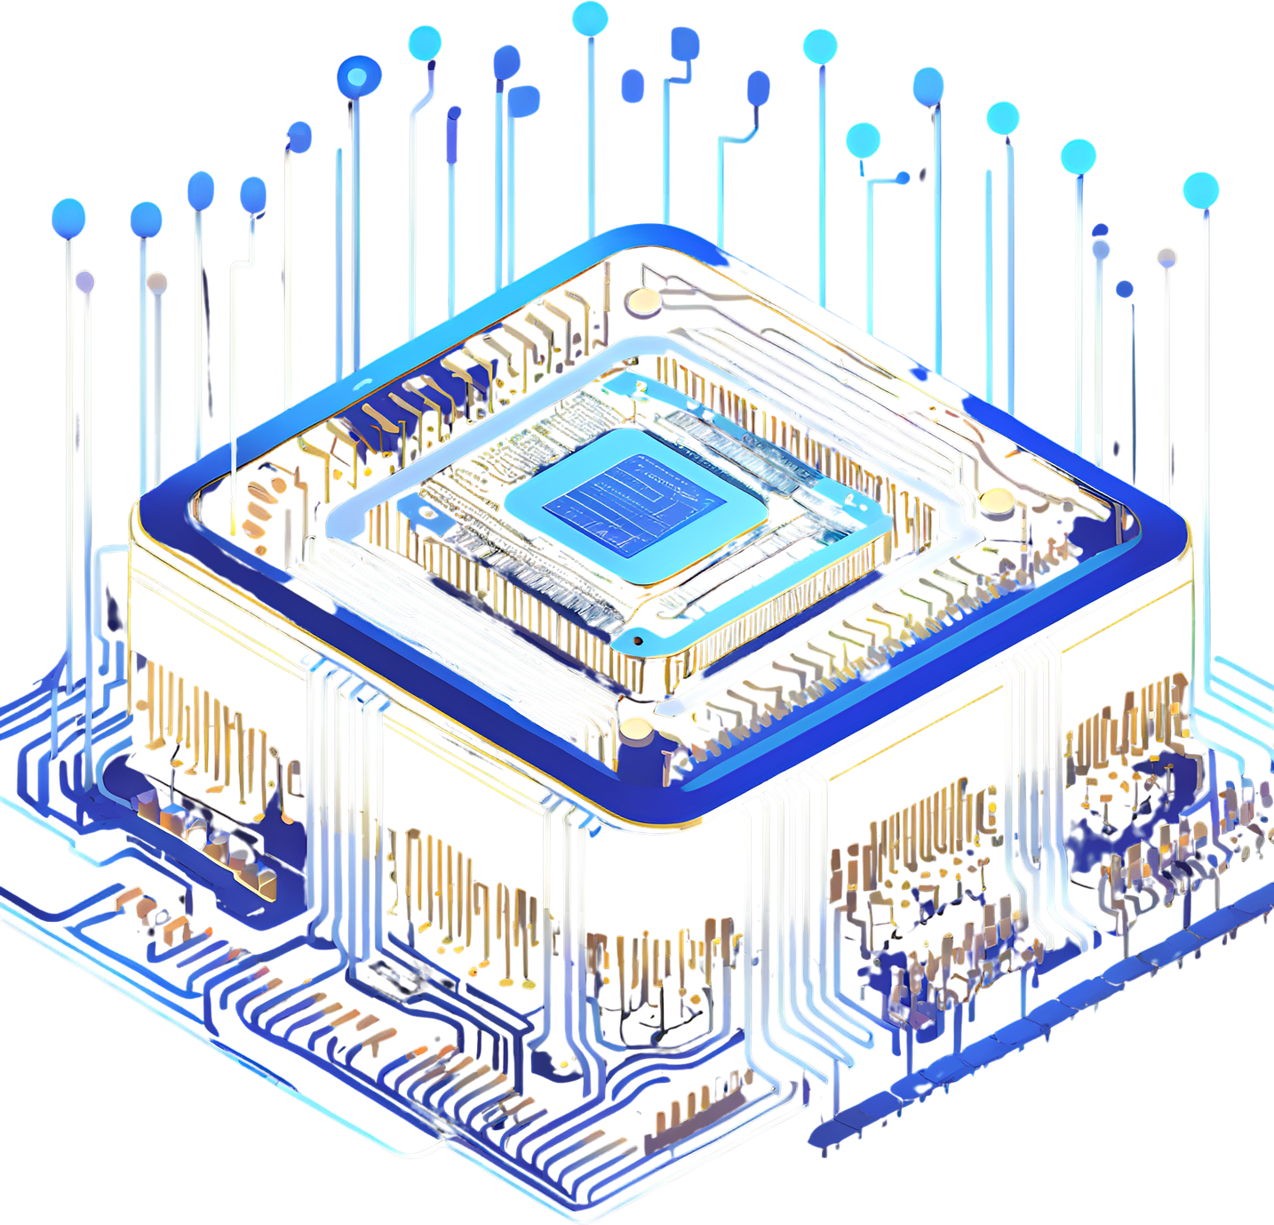
THANK YOU
TEAM MEMBERS:
CB.SC.U4CSE23520
CB.SC.U4CSE23542
CB.SC.U4CSE23566
CB.SC.U4CSE23537

